Slide 1

N.B.K.R INSTITUTE OF SCIENCE & TECHNOLOGY
(Autonomous)
Vidyanagar, Tirupati - 524413
Customer Churning Prediction using XGBOOST
Team Members (AI&DS):
1. Y. Samson(21KB1A30A2) 2. U. Siva Raju (21KB1A3093)
3. S. Sri Charan(21KB1A3089) 4. M. Lazar (21KB1A3054)
5. N. Charan Reddy(22KB5A3013)
Under the Guidance of
Mrs. P. Jyothi,
Assistant Professor,
Department of IT and AI&DS.

Slide 2
Index
INTRODUCTION
ABSTRACT
LITERATURE SURVEY
EXISTING AND PROPOSED SYSTEM
MODULES
SYSTEM ARCHITECTURE
ALGORITHEM EXPLANATION
DETAILED IMPLEMENTATION
SCREENSHOTS
CONCLUSION AND FUTURE ENHANCEMENT

Slide 3
Introduction
Customer retention is essential for business success. Retaining existing clients is significantly more cost-effective than acquiring new ones, making the reduction of customer churn a top priority.
Businesses struggle to identify customers at risk of churning before they leave. Proactive, early detection is key to effective intervention.
Machine learning provides powerful tools for analyzing complex customer behavior patterns and forecasting churn more accurately.
The primary objective of this project is to develop a superior machine learning system for churn prediction, improving both accuracy and efficiency.

Slide 4
Abstract
Traditional churn analysis often reacts to customer departure after it occurs. There is a need for effective systems that can predict potential churn before it happens.
This study enhances churn prediction by delivering more actionable insights through improved data handling, robust feature selection, and advanced machine learning techniques like XGBOOST.
This study enhances our understanding of churn by analyzing nine months of customer behavior, allowing a performance comparison with existing methods.
By proactively identifying churn risks, our system empowers businesses to implement more effective retention strategies, boosting customer lifetime value.

Slide 5
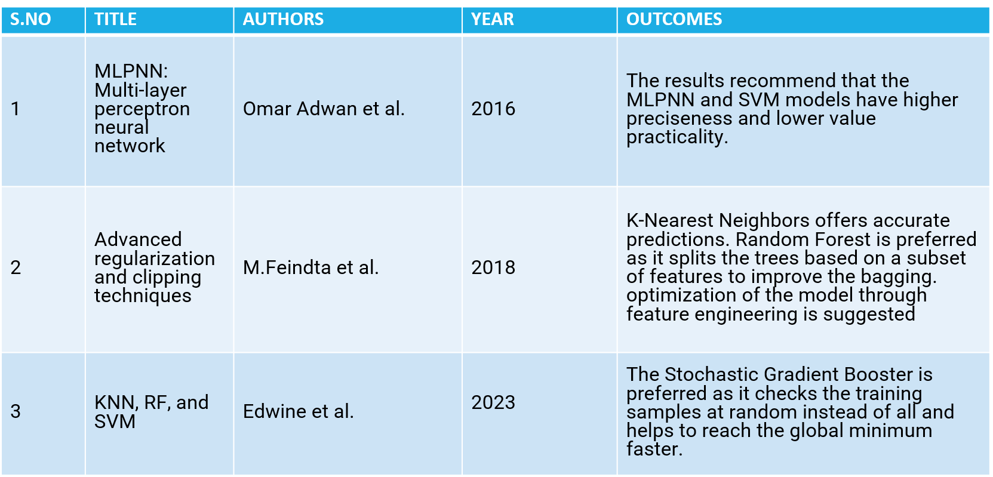
LITERATURE SURVEY

Slide 6
Existing System
Current churn analysis systems typically react after a customer has already left, which leads to missed opportunities for early intervention and retention.
Existing systems primarily used individual Machine learning algorithms like Logistic Regression, K-Nearest Neighbors, Random Forests, and Stochastic Gradient Boosters.
Many of these existing models do not include the critical steps for data preprocessing, like outlier removal and data balancing which causes poor performance
Existing methods use static features that may not provide a complete picture of changing customer activity patterns and may have lower accuracy

Slide 7
Disadvantages Of Existing System
Data Imbalance Issue
Sensitivity to Outliers
Limited Feature Set:
Lower Accuracy:

Slide 8
Proposed System
Uses machine learning models to predict churn early on, enabling businesses to take proactive action to retain at-risk customers.
Includes sophisticated data preprocessing techniques, like SMOTE oversampling, outlier detection, and feature engineering.
Employs dimensionality reduction through PCA to improve model efficiency and reduce overfitting.
We enhance predictive accuracy by utilizing advanced gradient boosting algorithms like XGBoost and CatBoost.

Slide 9
Advantages Of Proposed System
Improved Accuracy: The proposed system demonstrates greater accuracy in predicting customer churn due to better data handling and advanced algorithms.
Robust Model: The proposed model is more robust due to the application of outlier removal, oversampling and feature selection.
Actionable Insights: Our system provides not just predictions, but actionable insights into what drives churn, enabling targeted and effective retention efforts.
Better Retention Strategies: Ultimately, our system leads to more effective customer retention strategies and reduced costs for companies.

Slide 10
MODULES
Module 1: Data Collection & Preprocessing
Data Source: Kaggle dataset: Telco Customer Churn.
Data Cleaning:
Removed irrelevant column ('customerID').
Handled missing values in 'TotalCharges' by replacing them with 0.0.
Converted 'TotalCharges' to a numerical data type (float).
Addressing Data Imbalance:
Observed class imbalance in the 'Churn' variable.
Applied SMOTE (Synthetic Minority Over-sampling Technique) to balance the dataset and improve model performance.

Slide 11
Module 2: Exploratory Data Analysis (EDA)
Insights:
Analyzed numerical features ('tenure', 'MonthlyCharges', 'TotalCharges') using histograms and box plots, revealing distributions and potential outliers.
Explored categorical features using count plots to understand their frequencies and relationships with churn.
Calculated the correlation between numerical features using a heatmap.
Findings:
Identified patterns in customer behavior based on tenure, monthly charges, and total charges.
Observed relationships between categorical features and churn, such as contract type and internet service.

Slide 12
Module 3: Feature Engineering & Selection
Encoding Categorical Features:
Used Label Encoding to convert categorical columns ('SeniorCitizen', 'gender', 'Partner', etc.) into numerical representations for model compatibility.
Stored encoders using pickle for future use.
Module 4: Model Selection and Training
Models Considered:
CatBoost and XGBoost.
Model Performance:
Used 5-fold cross-validation to increase accuracy.

Slide 13
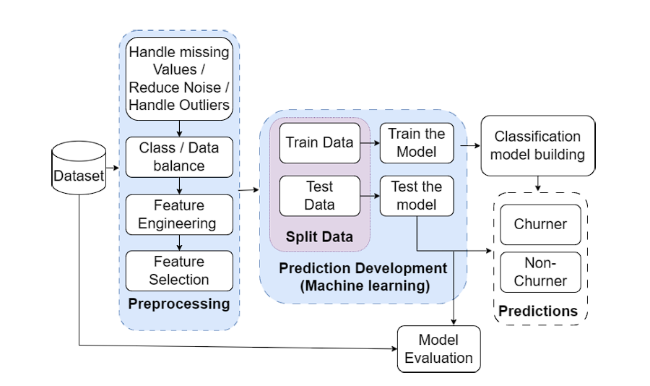
Architecture

Slide 14
Software Requirements
Operating System : | Windows 10, macOS, Linux.
Platform: | Python
Frontend: | No specific frontend requirement as the project focuses on backend data analysis and modeling.
Backend: | Python libraries such as Pandas for data manipulation, Scikit-learn formachine learning algorithms, and Matplotlib/Seaborn for data Visuals

Slide 15
HARDWARE Requirements
Processor | Intel Dual Core 2.00GHZ
Hard disk | 40 GB(minimum)
RAM | 4 GB(minimum)

Slide 16
Algorithm explanation
XGBoost (Extreme Gradient Boosting)
Introduction:
A powerful gradient boosting algorithm known for its high accuracy and efficiency.
Widely used in machine learning competitions and real-world applications.
Key Features:
Gradient Boosting: Builds an ensemble of decision trees sequentially, where each tree corrects the errors of its predecessors.
Regularization: Prevents overfitting by penalizing complex models, improving generalization.
Parallel Processing: Utilizes multiple cores for faster training.
Handling Missing Values: Built-in capabilities to handle missing data without imputation.
Advantages:
High predictive accuracy.
Handles missing vscalable.alues effectively.
Feature importance analysis.

Slide 17
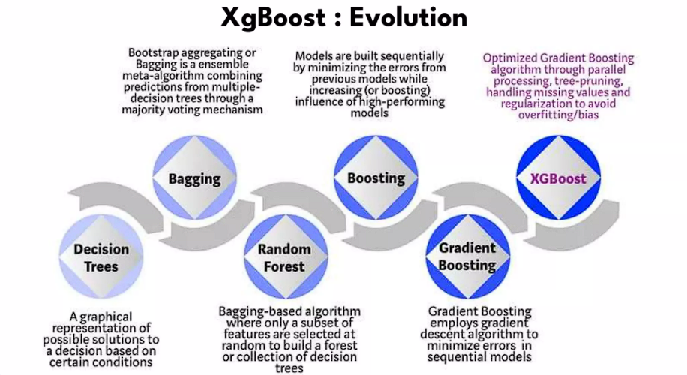
Start with an initial prediction:
This could be a simple average or a basic model.
Build a decision tree:
This tree tries to predict the errors in the initial prediction.
Add the tree's predictions to the initial prediction:
This improves the overall prediction.
Repeat steps 2 and 3:
Build more trees, each focusing on the remaining errors, until a stopping criterion is reached.

Slide 18
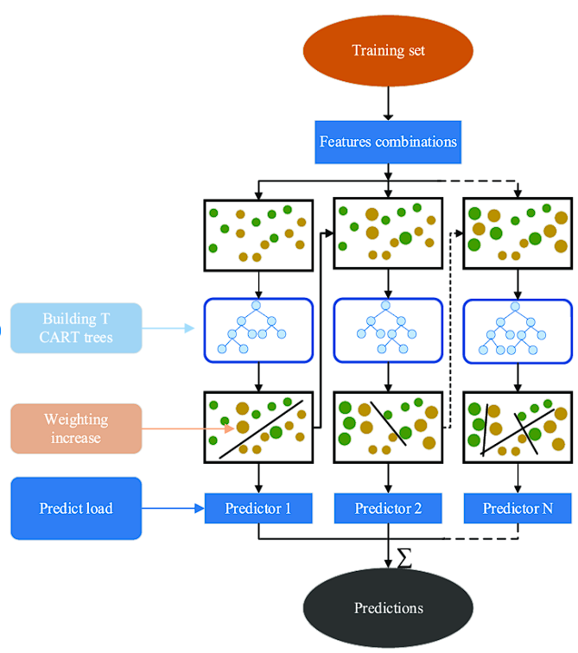

Slide 19
Detailed Implementation
#MODEL TRAINING
smote = SMOTE(random_state=42)
X_train_smote, y_train_smote = smote.fit_resample(X_train, y_train)
# Model training
models = {
'LogisticRegression': LogisticRegression(random_state=42),
'RandomForestClassifier': RandomForestClassifier(random_state=42),
'XGBClassifier': XGBClassifier(random_state=42)
}

Slide 20
best_model = None
best_accuracy = 0
for model_name, model in models.items():
model.fit(X_train_smote, y_train_smote)
y_pred = model.predict(X_test)
accuracy = accuracy_score(y_test, y_pred)
print(f'{model_name}: {accuracy:.4f}')
if accuracy > best_accuracy:
best_accuracy = accuracy
best_model = model print("Best model",best_model)
#OUTPUT
LogisticRegression: 0.7665 RandomForestClassifier: 0.7786 XGBClassifier: 0.7807
Best model: XGBClassifier(num_parallel_tree=None, random_state=42, ...)

Slide 21
import pickle
import pandas as pd
# Load the saved model and encoders
with open('best_model.pkl', 'rb') as f:
model = pickle.load(f)
with open('encoders.pkl', 'rb') as f:
encoders = pickle.load(f)
# Create a DataFrame with the input values
input_data = pd.DataFrame([[1.00, 0.00, 1.00, 0.00, 6.00, 1.00, 2.00, 1.00, 0.00, 0.00, 0.00, 0.00, 2.00, 0.00, 0.00, 1.00, 2.00, 82.85, 460.25]],
columns=['gender', 'SeniorCitizen', 'Partner', 'Dependents', 'tenure', 'PhoneService', 'MultipleLines', 'InternetService', 'OnlineSecurity', 'OnlineBackup', 'DeviceProtection', 'TechSupport', 'StreamingTV', 'StreamingMovies', 'Contract', 'PaperlessBilling', 'PaymentMethod', 'MonthlyCharges', 'TotalCharges’]) # Identify categorical columns
categorical_cols = ['gender', 'SeniorCitizen', 'Partner', 'Dependents', 'PhoneService', 'MultipleLines', 'InternetService', 'OnlineSecurity', 'OnlineBackup', 'DeviceProtection', 'TechSupport', 'StreamingTV', 'StreamingMovies', 'Contract', 'PaperlessBilling', 'PaymentMethod']

Slide 22
# Encode categorical columns and print encoded values
for col in categorical_cols:
# Replace unseen values with the most frequent category
valid_classes = encoders[col].classes_
input_data[col] = input_data[col].apply(lambda x: x if str(x) in valid_classes else valid_classes[0])
# Transform using the encoder
input_data[col] = encoders[col].transform(input_data[col].astype(str))
# Make a prediction
prediction = model.predict(input_data)[0]
# Print the result
if prediction == 1:
print("Churn")
else:
print("Not Churn") #OUTPUT
Churn

Slide 23
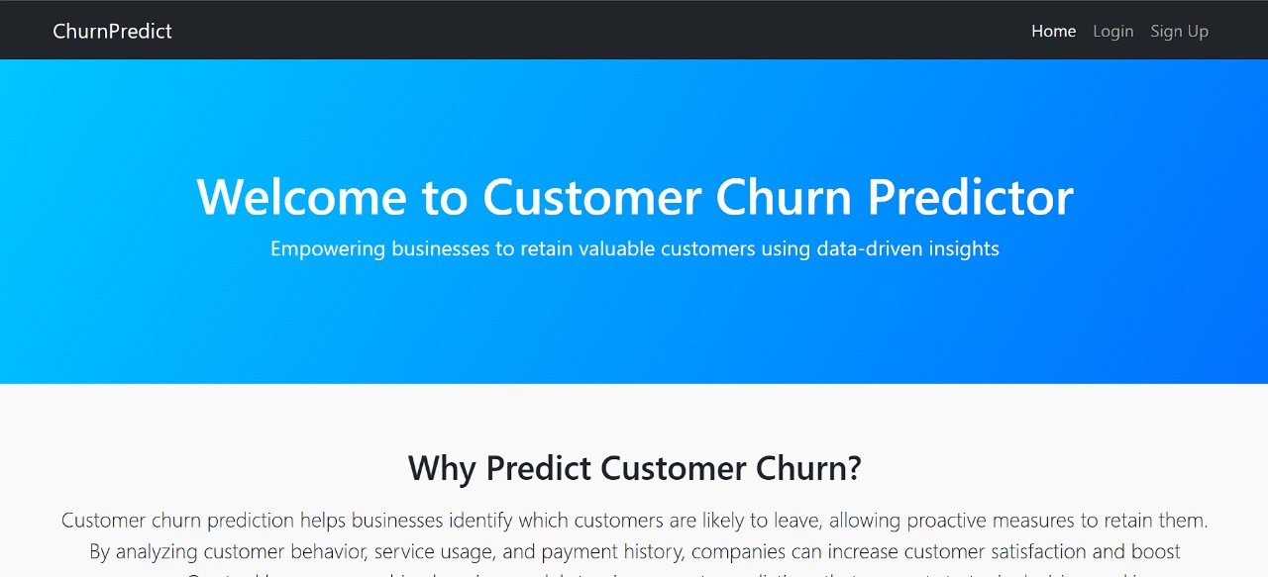
Screenshots

Slide 24
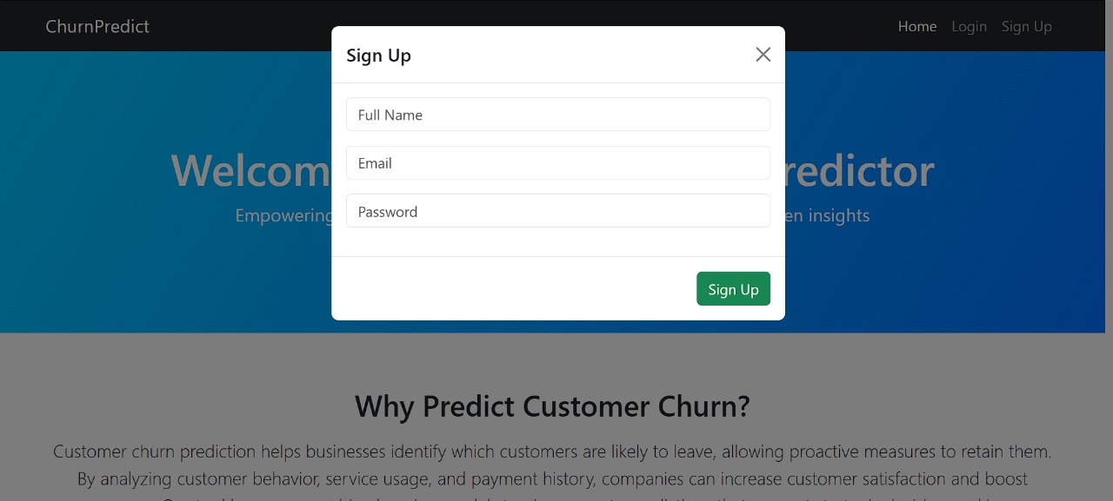
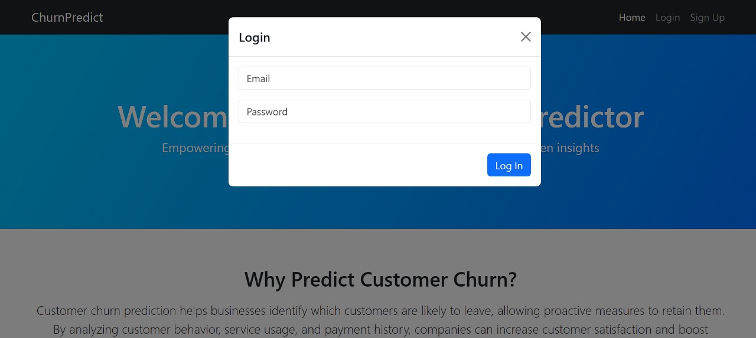

Slide 25
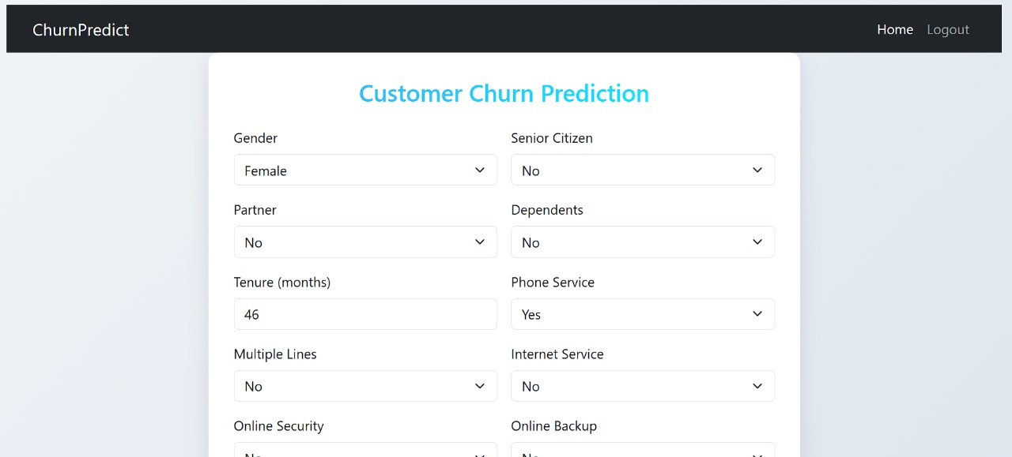
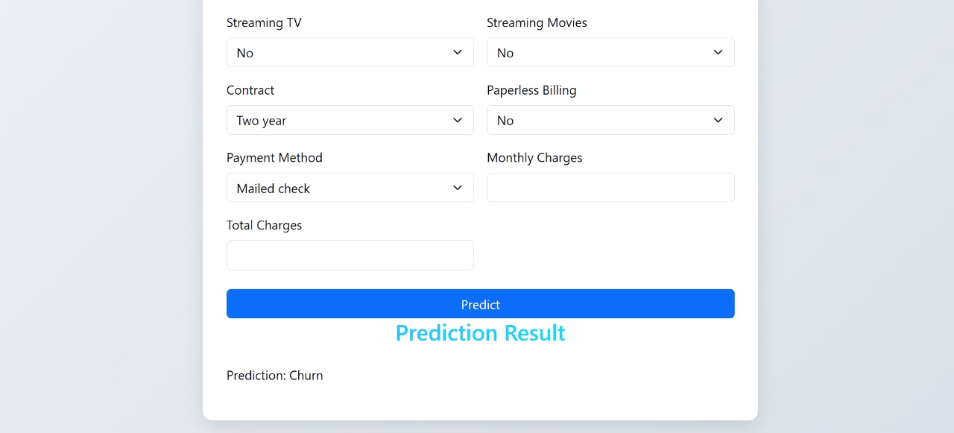

Slide 26
Conclusion
Customer Churn Model Development: We developed a predictive model for customer churn using the XGBoost algorithm, known for its high performance with structured data.
Handling Class Imbalance: To address the imbalance in churn labels, we applied SMOTE (Synthetic Minority Over-sampling Technique), which helped improve model sensitivity toward the minority class.
Performance Evaluation: We initially assessed model performance using accuracy. Moving forward, we aim to include precision, recall, and F1-score to better evaluate the model, particularly in light of the class imbalance.
Model Saving and Deployment: For reusability and smooth deployment, we saved the trained XGBoost model .

Slide 27
Future Enhacement
Model Deployment: We will deploy the model as a web service or API, allowing seamless integration with our existing systems and applications. This enables real-time access to churn predictions for new customer data.
Data Streaming and Preprocessing: We will integrate a data streaming pipeline to capture and preprocess real-time customer data, ensuring it's compatible with the model's input format. This involves handling missing values, encoding categorical features, and potentially generating new features.
Prediction API: We will develop an API endpoint that accepts customer data as input and returns the predicted churn probability in real-time. This enables other applications or systems within our organization to access churn predictions on demand.
Monitoring and Feedback Loop: We will implement a monitoring system to track the model's performance in real-time, identifying potential drifts or degradation. This feedback loop will trigger model retraining or updates to maintain accuracy and adaptability to evolving churn patterns.
Alerting and Actionable Insights: We will integrate an alerting mechanism to notify relevant stakeholders when a customer is identified as high-risk for churn. This allows for proactive interventions and personalized retention strategies to be implemented in a timely manner.

Slide 28
Reference
Omar Adwan, Hossam Faris, Khalid Jaradat, Osama Harfoushi, Nazeeh Ghatasheh, Predicting customer churn in telecom industry using multilayer preceptron neural networks: modeling and analysis, Life Sci. J. 11 (3) (2014) 75–81.
Mohammad Ridwan Ismail, Mohd Khalid Awang, M. Nordin A. Rahman, Mokhairi Makhtar, A multi-layer perceptron approach for customer churn prediction, International Journal of Multimedia and Ubiquitous Engineering 10 (7) (2015) 213–222.
Farhad Shaikh, Brinda Pardeshi, Ajay Jachak, Akash Bendale, Nandakishor Sonune, Mangal Katkar, Customer churn prediction using nlp and machine learning: an overview, International Journal Of Advance Scientific Research And Engineering Trends 6 (2) (2021) 40–45.
Anuj Sharma, DrPrabin Kumar Panigrahi, A neural network based approach for predicting customer churn in cellular network services, Int. J. Comput. Appl. 27 (11) (2011) 26–31.
Ammara Ahmed, D. Maheswari Linen, A review and analysis of churn prediction methods for customer retention in telecom industries, in: 2017 4th International Conference on Advanced Computing and Communication Systems (ICACCS), IEEE, 2017, pp. 1–7.

Slide 29
Thank You

